Slide 1
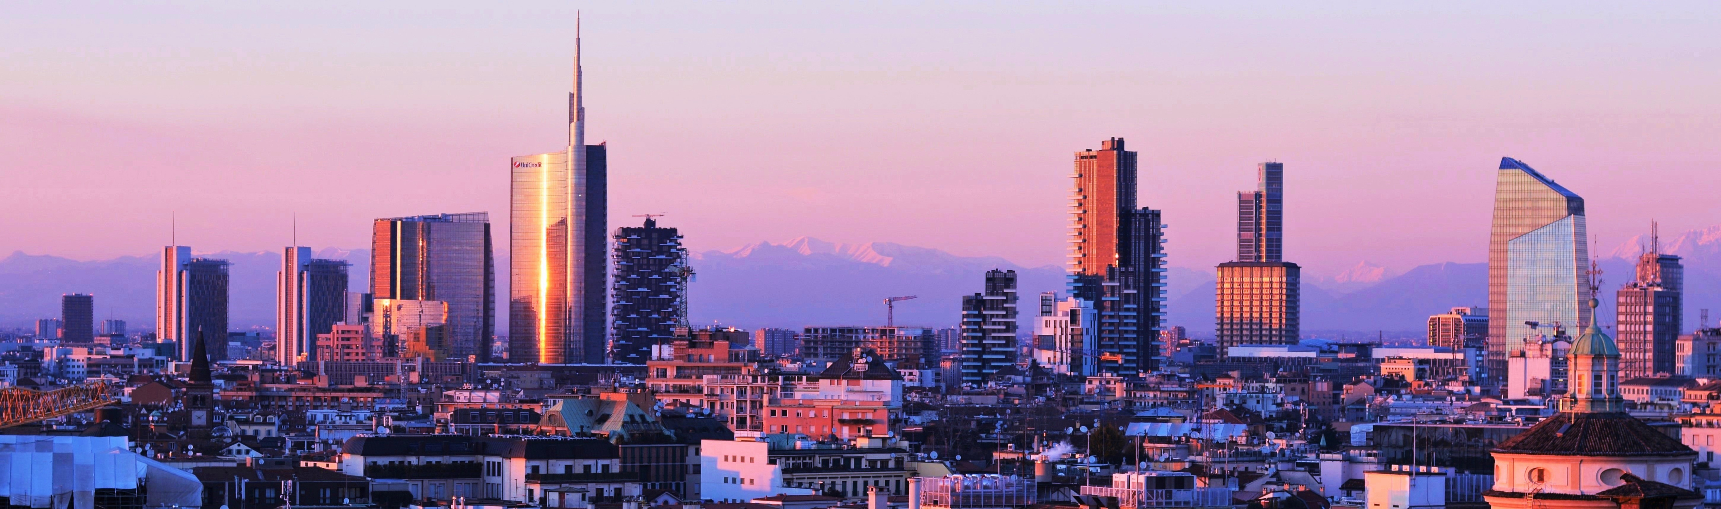

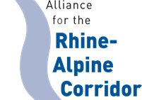
The Metropolitan City of Milan & EGTC Rhine-Alpine Corridor
Presented by:
Dario Parravicini
Corridor Conference
25th September

Slide 2



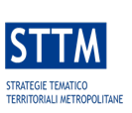
Regulation Framework
Piano Urbano Mobilità Sostenibile
The Metropolitan Territorial
Thematic
Strategies
MCM into
EGTC
2021
  2024
  2024
PULS
The Metropolitan Territorial Plan
BiciPlan CAMBIO
Piano Urbano Logistica Sostenibile
2021
  2022
2024

Slide 3

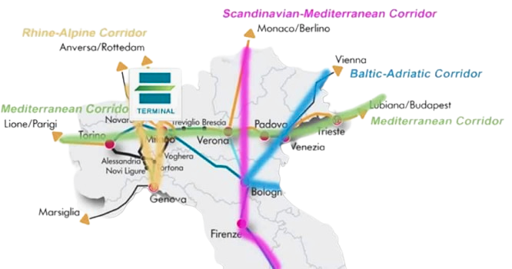

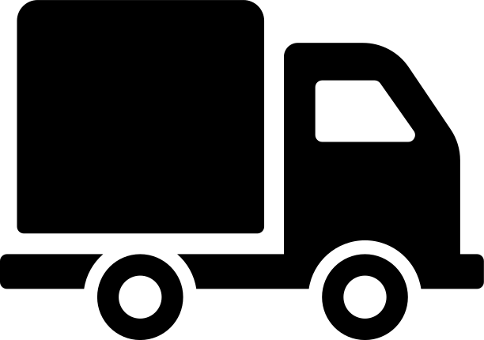

Logistic Region of Milan
348 thousand freight vehicles per day
300 million tons
of goods transported
280 million tons of goods transported via trucks
4th place concerning efficiency in Regional Logistic Index

Slide 4
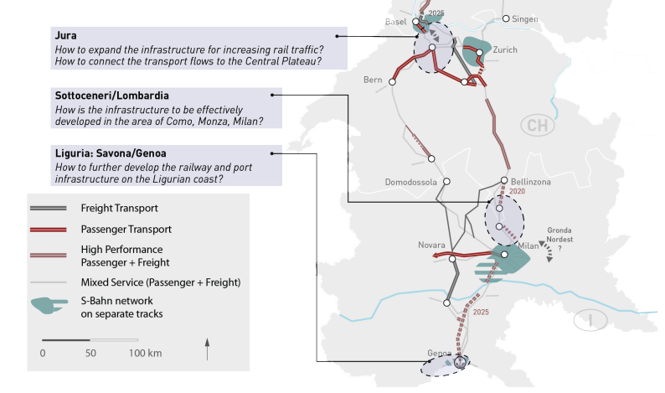
Driving the Modal Shift in TEN-T Urban and Regional Nodes

Slide 5
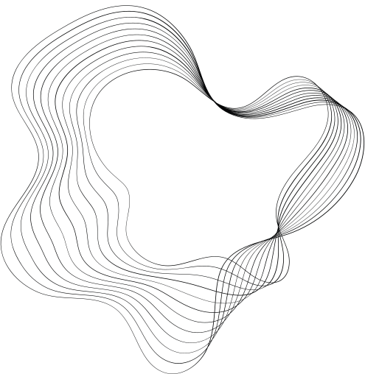
THANK'S FOR WATCHING
Corridor Conference
25th September
Presented by:
Dario Parravicini

